Slide 1
QCar System Identification and CARLA Digital Twin Development
ZHANG Haolin, ZHANG Shiyu, WANG Qixin
Apr 22, 2024

Slide 2
A brief word
The QCar dataset now are publicly available at
https://github.com/QixinWangCpsLab/QCarDataSet
(The corresponding paper, QCar Data Set for Building QCar Digital Twins, is under drafting)
Case Study: QCar Digital Twin

Slide 3
Table of Contents
Background
QCar Dataset
QCar System Identification
QCar Digital Twin in Carla

Slide 4
Background
Real-world traffic inferences exist in real-world smart vehicle datasets
Sometimes, it is good, especially for exploring driving policy
Sometimes, it is terrible because it constraints the state space
Conducting smart vehicle experiments in labs is impractical
Huge space cost and finial cost

Slide 5
Background
Conduct experiments in labs with
Miniaturized Smart Vehicle (MinSV)
Miniaturized Road System (MinRS)
Might also be impossible to build a large dataset when considering
Wear down issue
Huge time cost

Slide 6
Background
Create a digital twin can solve this issue
real-world MinSV (PHY-MinSV) -> cyber-world MinSV digital twin (DT-MinSV)
real-world MinRS (PHY-MinRS) -> cyber-world MinRS digital twin (DT-MinRS)
Then, the data collection experiment could be conducted in a hybrid mode (aka “emulation”)
Part of experiment are in the real world and the rest are in the cyber world
In addition, the DT-MinSV can be used for other tasks
E.g., online decision making

Slide 7
Background
To build DT-MinSV, large number of real-world driving data of PHY-MinSV are needed
PHY-MinSV involves sophisticated nonlinear component
Demands big data based (instead of analytical) system identification

Slide 8
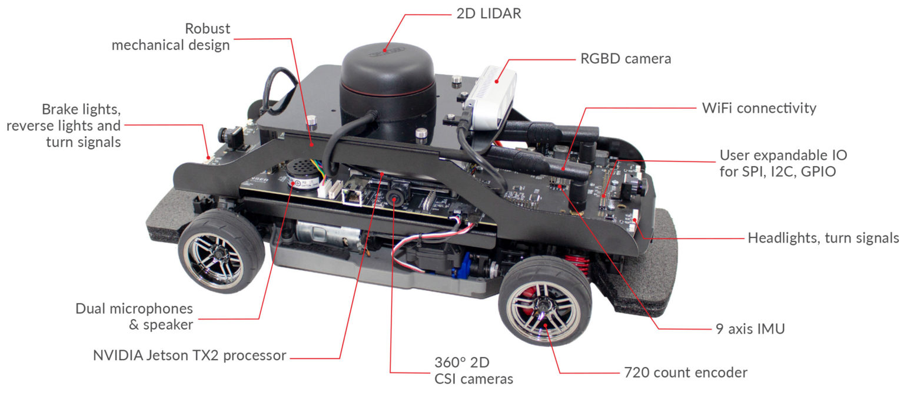
QCar Dataset
Quanser QCar is our PHY-MinSV
Sensor Rich
A similar dynamic behavior to an on-road vehicle
4WD 1/10 RC Platform
User friendly API
Quanser QCar Sensors
from Quanser, available at https://www.quanser.com/products/qcar/

Slide 9
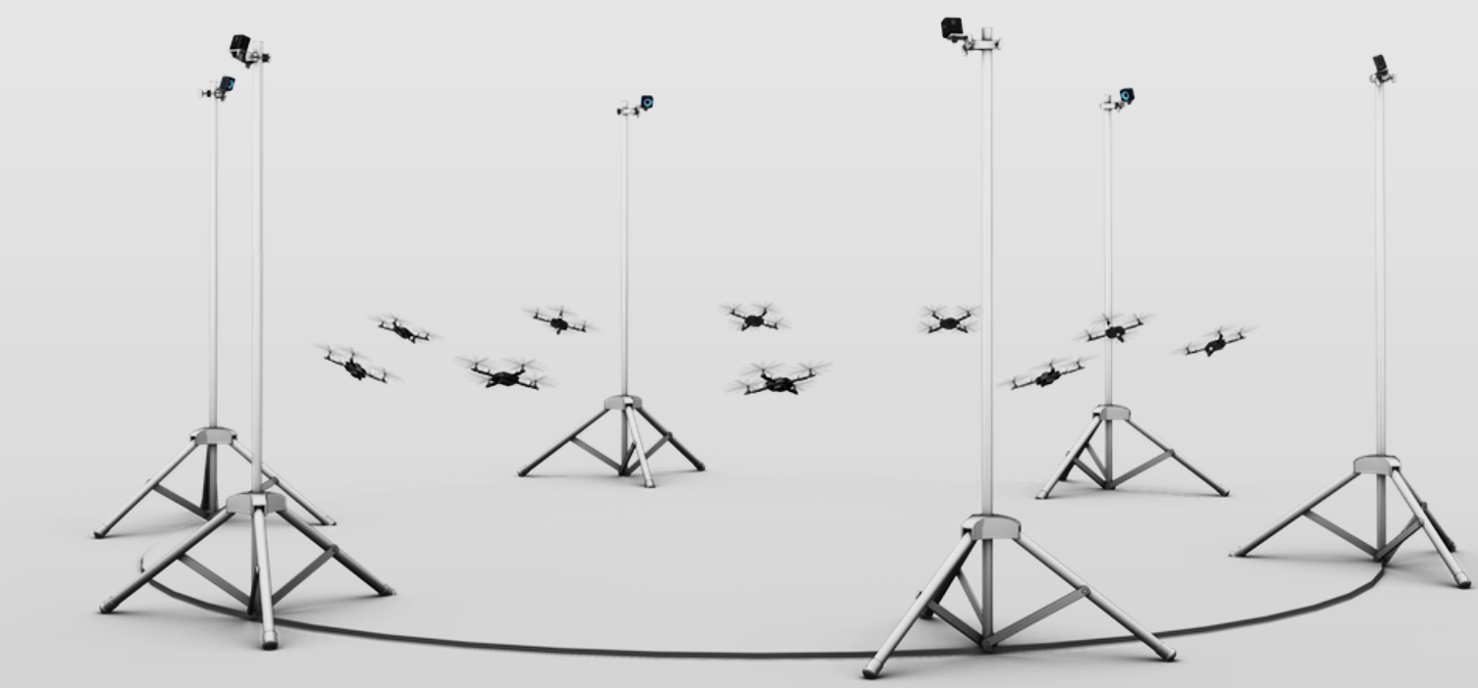
QCar Dataset
OptiTrack system records the QCar’s trajectory
A vision-based positioning system
Camera array (6 cameras in our setup)
Rigid body Marker (placed on QCar)
High Accuracy
Sub-millimeter error
High Refresh Rate
Maximal 250 frame per second
OptiTrack System
from OptiTrack, available at https://www.quanser.com/products/qcar/

Slide 10
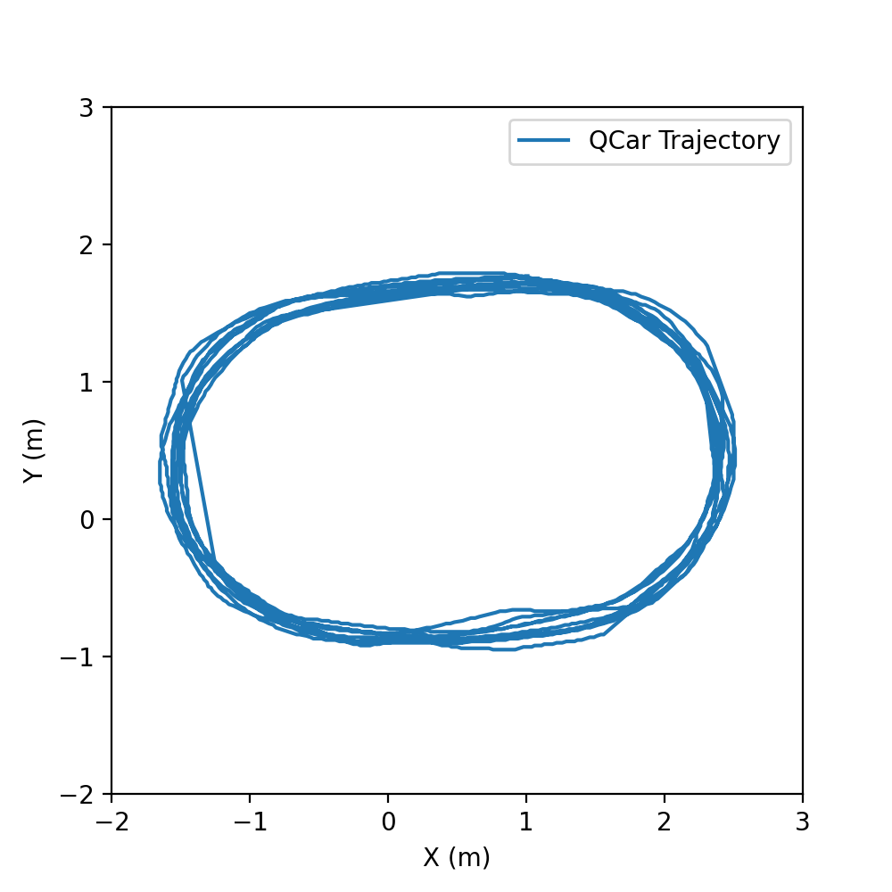
QCar Dataset
Data Collection Campaign
The 2022 Campaign
PHY-MinRS: Track-and-Field Road System from the QCar package
The QCar is derived by a human operator, aka the Manual Drive controller, through an Xbox Controller.
Note: The control signal is the raw percentage of the throttle and steering. No additional control algorithm is applied.
Experiment Settings
Clockwise, Forward
Clockwise, Backward
Counterclockwise, Forward
Counterclockwise, Backward

Slide 11
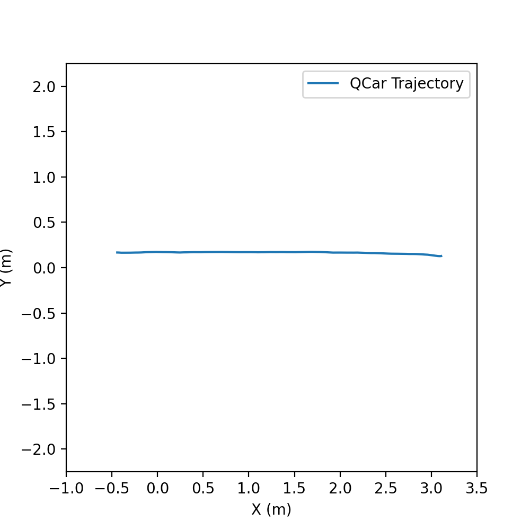
QCar Dataset
Data Collection Campaign
The 2023 Campaign
PHY-MinRS: Straight Road System from the QCar package
The QCar is steered by two controller
Closed-loop controller: A line following program came with the QCar
Open-loop controller: Always output steering signal of 0 to the QCar
The throttle is from one of the five signal generators
Sine wave
Triangle wave
Constant Function
Square Root Function
Quadratic Function

Slide 12
QCar Dataset
Experiment Procedure
OptiTrack System
Onboard Sensor
Setup MinRS
(re)Calibrate the OptiTrack System
Sensor Reading
Controller
Cached Logs
Run at 20Hz
Flush the logs to the disk

Slide 13
QCar Dataset
Available at https://github.com/QixinWangCpsLab/QCarDataSet
File Structure
Root Directory
\---QCarDataSet
+---linefollow_constant
| - 2023_0.csv
| - 2023_1.csv
| ……
+---manual_clockwise_backward
+---openloop_triangle
……
Line follow Steering Controller with the constant throttle Controller
The data segment with id=0, collected in the 2023 campaign
The QCar is driven by a Manual Drive controller backward and clockwise around the track.

Slide 14
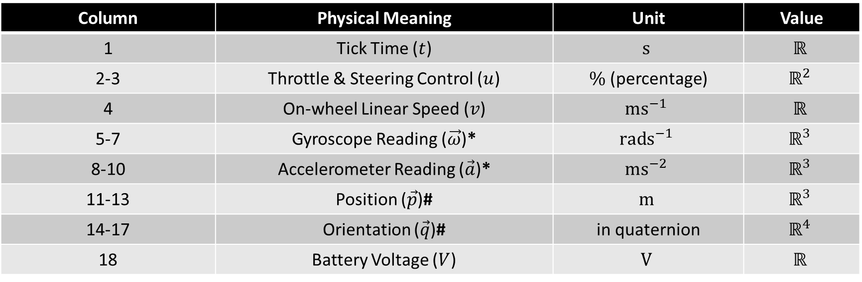
QCar Dataset
Data Format
CSV format. Each data field is separated by a comma (,).
Within each tick,
Column | Physical Meaning | Unit | Value
1 | Tick Time ($t$) | $$s$$ | $$ℝ$$
2-3 | Throttle & Steering Control ($u$) | $\%$ (percentage) | $$ℝ^{2}$$
4 | On-wheel Linear Speed ($v$) | $$ms^{−1}$$ | $$ℝ$$
5-7 | Gyroscope Reading ($\vec{ω}$)* | $$rads^{−1}$$ | $$ℝ^{3}$$
8-10 | Accelerometer Reading ($\vec{a}$)* | $$ms^{−2}$$ | $$ℝ^{3}$$
11-13 | Position ($\vec{p}$)# | $$m$$ | $$ℝ^{3}$$
14-17 | Orientation ($\vec{q}$)# | in quaternion | $$ℝ^{4}$$
18 | Battery Voltage ($V$) | $$V$$ | $$ℝ$$
* means in the vehicle frame of reference; # means in the global (inertial) frame of reference

Slide 15
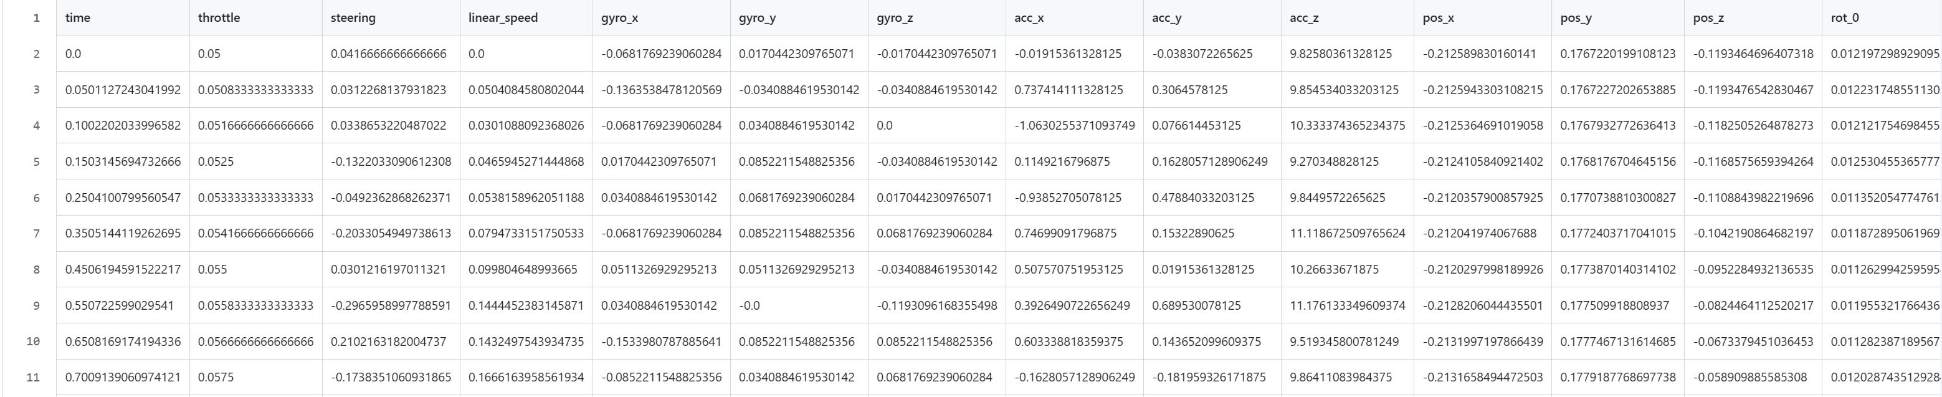
QCar Dataset
Data Format
Sample data segment (available at https://github.com/QixinWangCpsLab/QCarDataSet/blob/main/sample.csv)
(not all columns are listed here due to the length limit)

Slide 16
QCar Dataset
Segmentation Issue
The time of data collected in the 2022 campaign may not start from zero
the human operator accidentally released the safety button during several trials
Position or Orientation failed to update
The QCar runs out of the view of OptiTrack System
Package loss due to network
As people have different thoughts to tackle this issue, the released dataset is not being processed but the original output. The user shall process the data as needed.

Slide 17
QCar System Identification
We try to identify the longitudinal model of the QCar
According to Rajesh, longitudinal dynamics is a joint behavior from the motor, tire, aerodynamic, rolling resistance, and gravitational forces
Theoretical Model:
$$\dot{V_{x}}=C_{σf}\frac{r_{eff}ω_{w}−V_{x}}{r_{eff}mω_{w}}+C_{σr}\frac{r_{eff}ω_{w}−V_{x}}{r_{eff}mω_{w}}−\frac{C_{aero}}{m} V_{x}^{2}−\frac{f}{m}F_{zf}−\frac{f}{m}F_{zr}−g\sin\left(θ\right)+N_{3}(V_{x},ω_{w})$$
$${\dot{ω}}_{w}=τ(C_{σf}\frac{r_{eff}ω_{w}−V_{x}}{r_{eff}ω_{w}},C_{σr}\frac{r_{eff}ω_{w}−V_{x}}{r_{eff}ω_{w}},fF_{zf},fF_{zr},C_{aero}V_{x}^{2}, mg\sin\left(θ\right),θ)$$
$${\hat{V}}_{x}\left(t+δt\right)={\hat{V}}_{x}\left(t\right)+{\hat{\dot{V}}}_{x}\left(t\right)δt$$
Red: unknown coefficient or relationship
$${\hat{ω}}_{w}\left(t+δt\right)={\hat{ω}}_{w}\left(t\right)+{\hat{\dot{ω}}}_{w}\left(t\right)δt$$
Reference: Rajesh Rajamani, Vehicle Dynamics and Control Second Edition, 2012, Springer

Slide 18
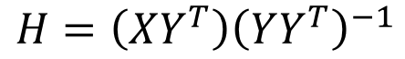
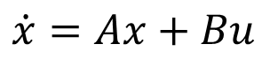
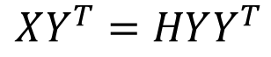
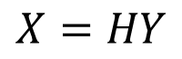
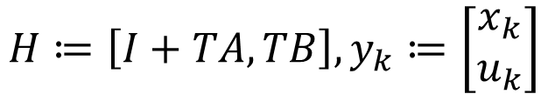
Method 1: Linear SI
$$\dot{x}=Ax+Bu$$
$$x_{k+1}=x_{k}+TA_{k}+TBu_{k}=\left(I+TA\right)x_{k}+TB_{u}=\left[I+TA, TB\right]\left[\begin{matrix}x_{k} \\ u_{k}\end{matrix}\right]$$
$$H≔\left[I+TA, TB\right], y_{k}≔\left[\begin{matrix}x_{k} \\ u_{k}\end{matrix}\right]$$
$$X≔\left[x_{2},x_{3},…, x_{m}\right], Y≔[y1, y2, …, y_{m−1}]$$
$$X=HY$$
$$XY^{T}=HYY^{T}$$
$$H=\left(XY^{T}\right){\left(YY^{T}\right)}^{−1}$$

Slide 19
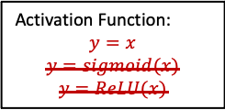
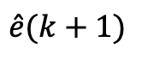
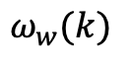
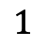
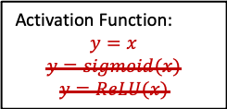
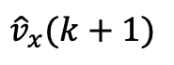
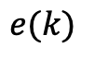
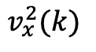
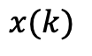
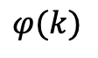
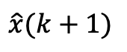
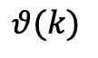
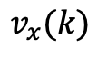

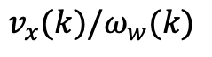

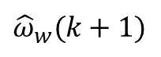
Method 2: Naive PhyTaylor SI
Signal Compressor
Activation Function:
$$y=x$$
$$y=sigmoid(x)$$
$$y=ReLU(x)$$
$$x(k)$$
$$\hat{x}(k+1)$$
Signal Compressor
Activation Function:
$$y=x$$
$$y=sigmoid(x)$$
$$y=ReLU(x)$$
$$v_{x}(k)$$
$${\hat{v}}_{x}(k+1)$$
encoder reading (corresponding to wheel angle)
Activation Function:
$$y=x$$
$$y=sigmoid(x)$$
$$y=ReLU(x)$$
$$e(k)$$
Signal Compressor
$$\hat{e}(k+1)$$
Activation Function:
$$y=x$$
$$y=sigmoid(x)$$
$$y=ReLU(x)$$
Signal Compressor
One-hop Fully Connected Linear Layer (without Link Editing)
$${\hat{ω}}_{w}(k+1)$$
$$ω_{w}(k)$$
Taylor Augmentation Order 1
$$1$$
Signal Compressor
Inspired by the physical knowledge
(Augmented)
$$v_{x}^{2}(k)$$
Signal Compressor
$$v_{x}(k)/ω_{w}(k)$$
Signal Compressor
$$θ(k)$$
Signal Compressor
PhyTaylor
$$φ(k)$$
Signal Compressor

Slide 20
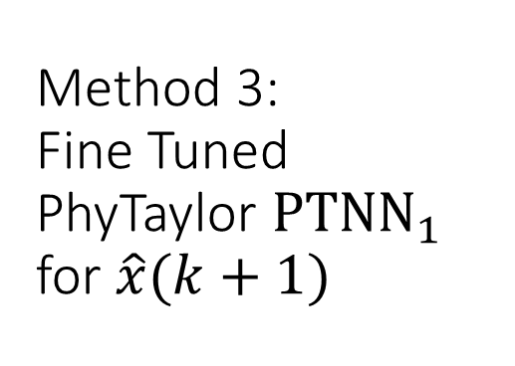
Link Editing:
Method 3: Fine Tuned PhyTaylor ${PTNN}_{1}$ for $\hat{x}(k+1)$
Signal Compressor
0
1
Activation Function:
$$y=x$$
$$y=sigmoid(x)$$
$$y=ReLU(x)$$
$$x(k)$$
0
$$\hat{x}(k+1)$$
Signal Compressor
2
3
Activation Function:
$$y=x$$
$$y=sigmoid(x)$$
$$y=ReLU(x)$$
$$v_{x}(k)$$
1
$${\hat{v}}_{x}(k+1)$$
Taylor Augmentation Order 1
Edge 0 → 0, 1 → 0: 1.0;
Edge 2 → 0, 3 → 0: 0;
Edge others → 0: *.
$$1$$
Signal Compressor
4
5
$$v_{x}^{2}(k)$$
Signal Compressor
6
7
weight = known constant
One-hop Fully Connected Linear Layer (with Link Editing)
$$v_{x}(k)/ω_{w}(k)$$
Signal Compressor
8
9
weight = 0
10
11
$$θ(k)$$
Signal Compressor
PhyTaylor
weight to be learnt
$$φ(k)$$
Signal Compressor
12
13

Slide 21
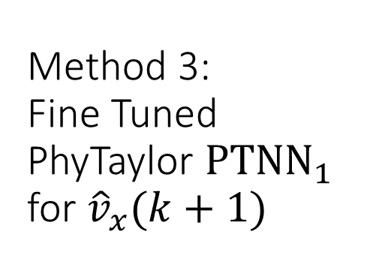
Link Editing:
Method 3: Fine Tuned PhyTaylor ${PTNN}_{1}$ for ${\hat{v}}_{x}(k+1)$
Signal Compressor
0
1
Activation Function:
$$y=x$$
$$y=sigmoid(x)$$
$$y=ReLU(x)$$
$$x(k)$$
0
$$\hat{x}(k+1)$$
Signal Compressor
2
3
Activation Function:
$$y=x$$
$$y=sigmoid(x)$$
$$y=ReLU(x)$$
$$v_{x}(k)$$
1
$${\hat{v}}_{x}(k+1)$$
Taylor Augmentation Order 1
Edge 0 → 0, 1 → 0: 1.0;
Edge 2 → 0, 3 → 0: 0;
Edge others → 0: *.
Edge 0 → 1, 1 → 1: 0;
Edge 2 → 1, 3 → 1: 1.0;
Edge others → 1: *.
$$1$$
Signal Compressor
4
5
$$v_{x}^{2}(k)$$
Signal Compressor
6
7
One-hop Fully Connected Linear Layer (with Link Editing)
$$v_{x}(k)/ω_{w}(k)$$
Signal Compressor
8
9
$$θ(k)$$
Signal Compressor
10
11
PhyTaylor
$$φ(k)$$
Signal Compressor
12
13

Slide 22
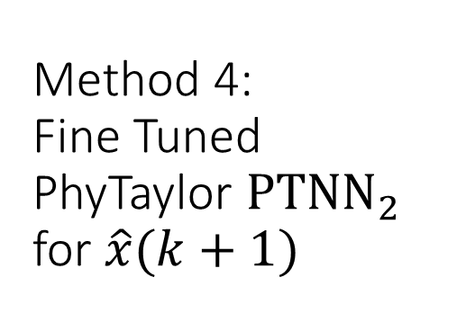
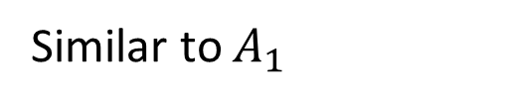
Link Editing:
Method 4: Fine Tuned PhyTaylor ${PTNN}_{2}$ for $\hat{x}(k+1)$
Signal Compressor
0
1
Activation Function:
$$y=x$$
$$y=sigmoid(x)$$
$$y=ReLU(x)$$
$$x(k)$$
0
$$\hat{x}(k+1)$$
Signal Compressor
2
3
Activation Function:
$$y=x$$
$$y=sigmoid(x)$$
$$y=ReLU(x)$$
$$v_{x}(k)$$
1
$${\hat{v}}_{x}(k+1)$$
Taylor Augmentation Order 1
Similar to $A_{1}$
$$1$$
Signal Compressor
4
5
$$v_{x}^{2}(k)$$
Signal Compressor
6
7
3 Layer-MLP
$$v_{x}(k)/ω_{w}(k)$$
Signal Compressor
8
9
$$θ(k)$$
Signal Compressor
10
11
PhyTaylor
$$φ(k)$$
Signal Compressor
12
13

Slide 23
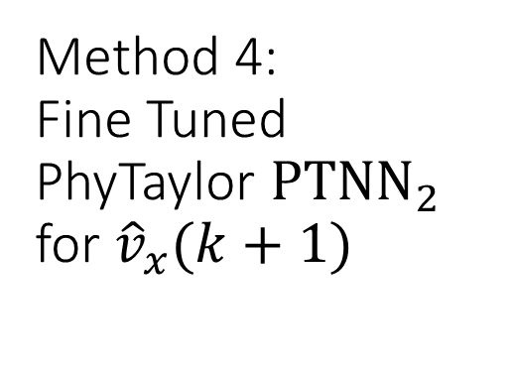
Link Editing:
Method 4: Fine Tuned PhyTaylor ${PTNN}_{2}$ for ${\hat{v}}_{x}(k+1)$
Signal Compressor
0
1
Activation Function:
$$y=x$$
$$y=sigmoid(x)$$
$$y=ReLU(x)$$
$$x(k)$$
0
$$\hat{x}(k+1)$$
Signal Compressor
2
3
Activation Function:
$$y=x$$
$$y=sigmoid(x)$$
$$y=ReLU(x)$$
$$v_{x}(k)$$
1
$${\hat{v}}_{x}(k+1)$$
Taylor Augmentation Order 1
Similar to $A_{1}$
$$1$$
Signal Compressor
4
5
$$v_{x}^{2}(k)$$
Signal Compressor
6
7
3 Layer-MLP
$$v_{x}(k)/ω_{w}(k)$$
Signal Compressor
8
9
$$θ(k)$$
Signal Compressor
10
11
PhyTaylor
$$φ(k)$$
Signal Compressor
12
13

Slide 24
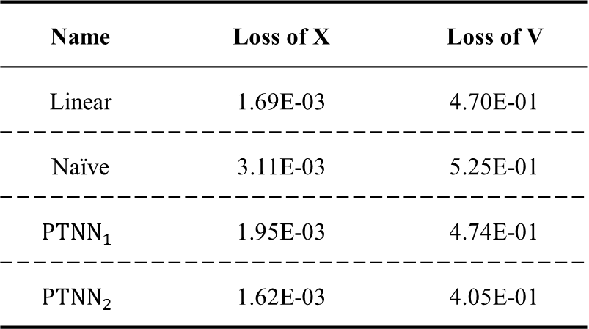
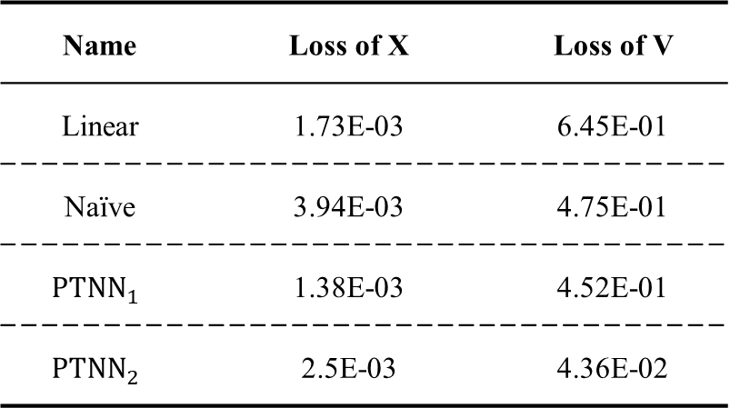
Preliminary Result
Name | Loss of X | Loss of V
Linear | 1.73E-03 | 6.45E-01
Naïve | 3.94E-03 | 4.75E-01
$${PTNN}_{1}$$ | 1.38E-03 | 4.52E-01
$${PTNN}_{2}$$ | 2.5E-03 | 4.36E-02
Name | Loss of X | Loss of V
Linear | 1.69E-03 | 4.70E-01
Naïve | 3.11E-03 | 5.25E-01
$${PTNN}_{1}$$ | 1.95E-03 | 4.74E-01
$${PTNN}_{2}$$ | 1.62E-03 | 4.05E-01
Table of Validation Loss on Acceleration Mode
Table of Validation Loss on Deceleration Mode

Slide 25
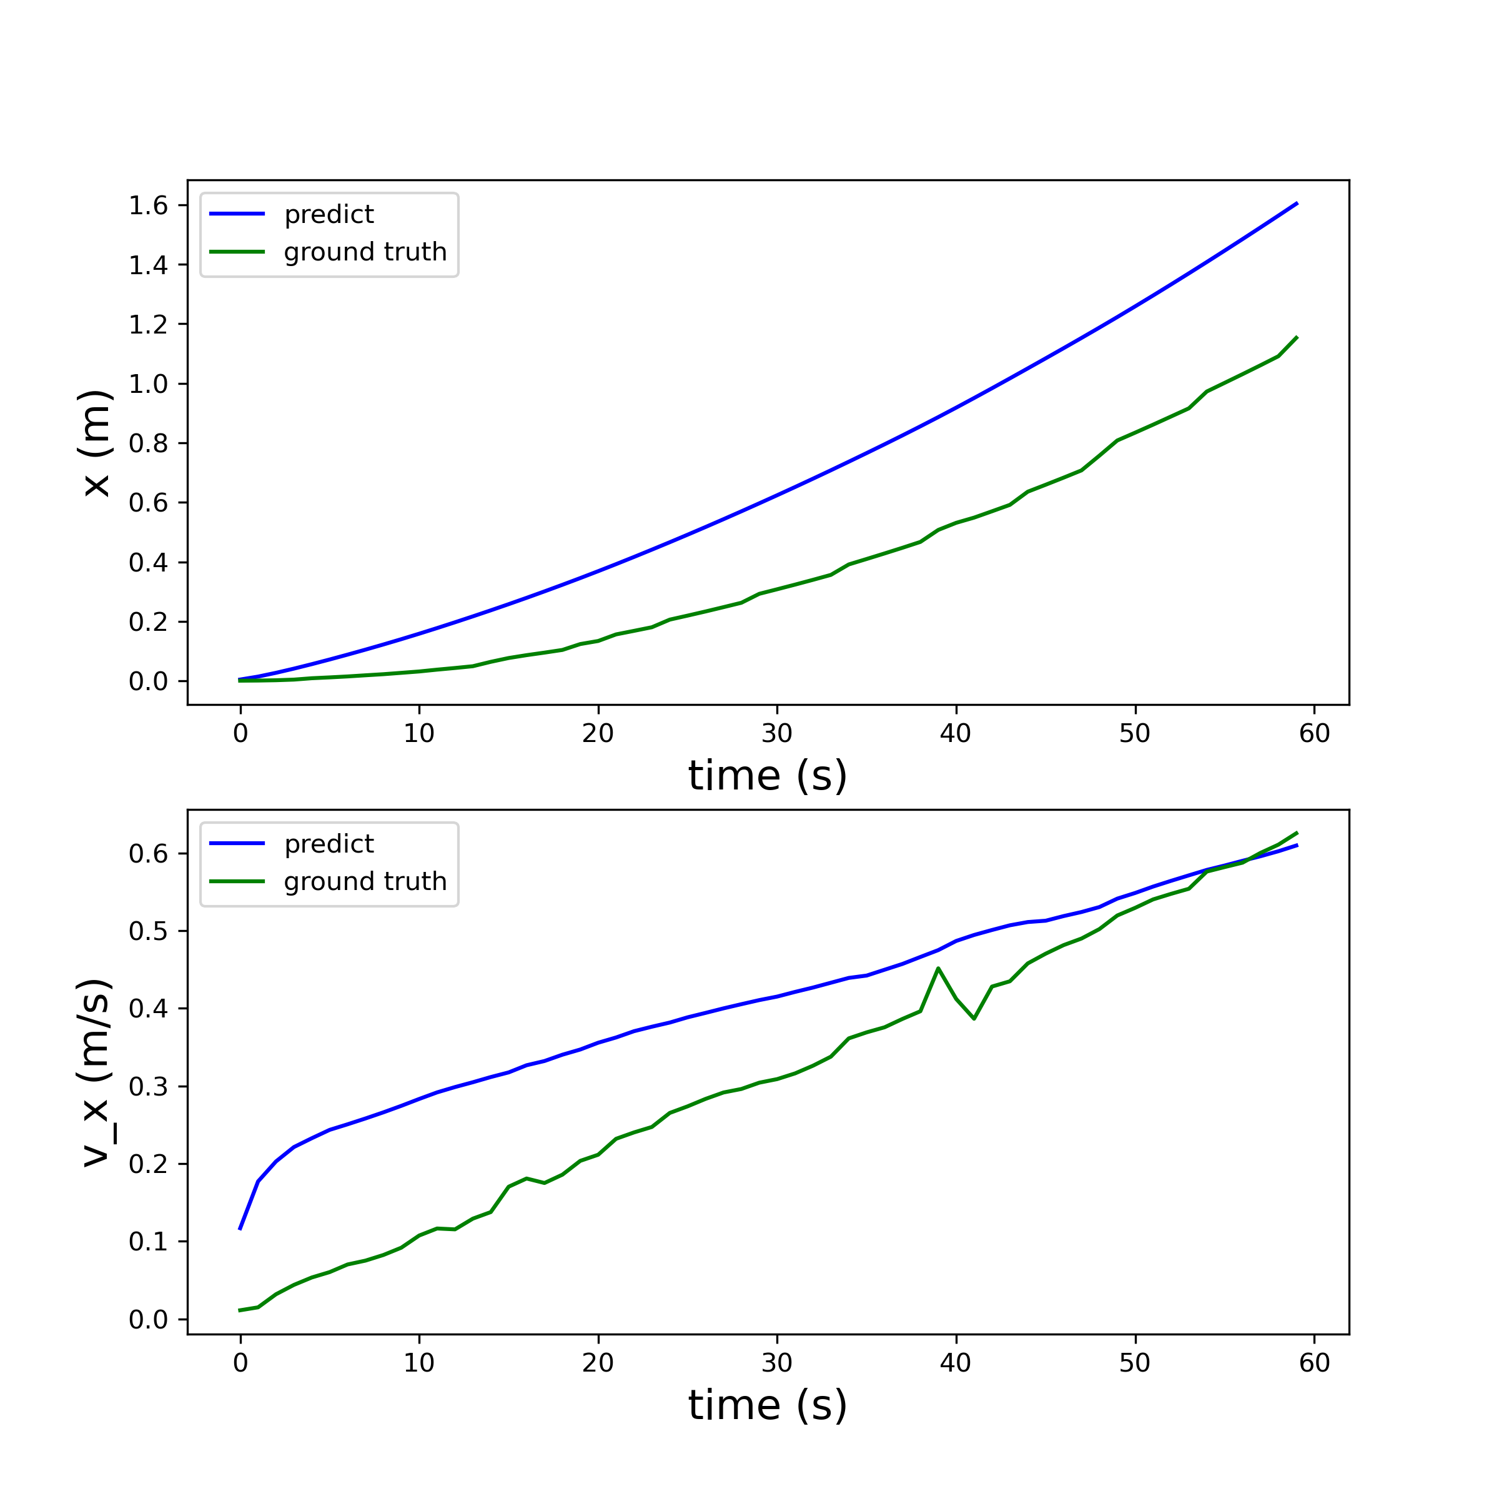
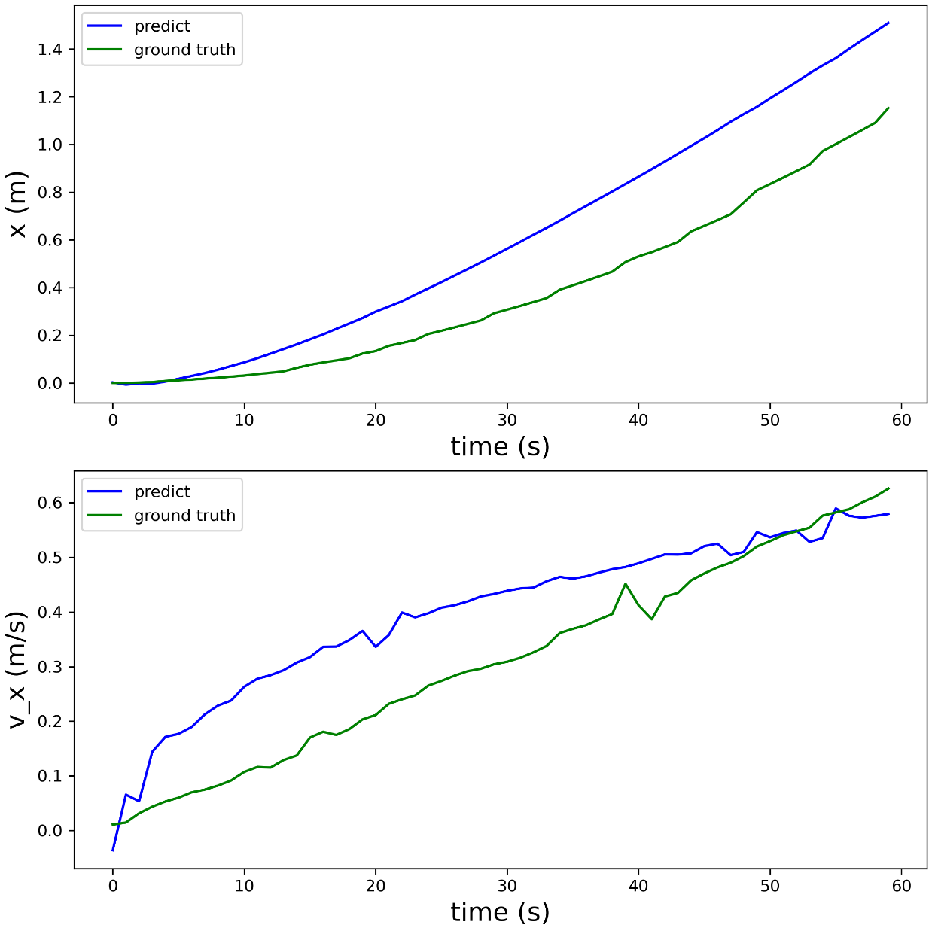
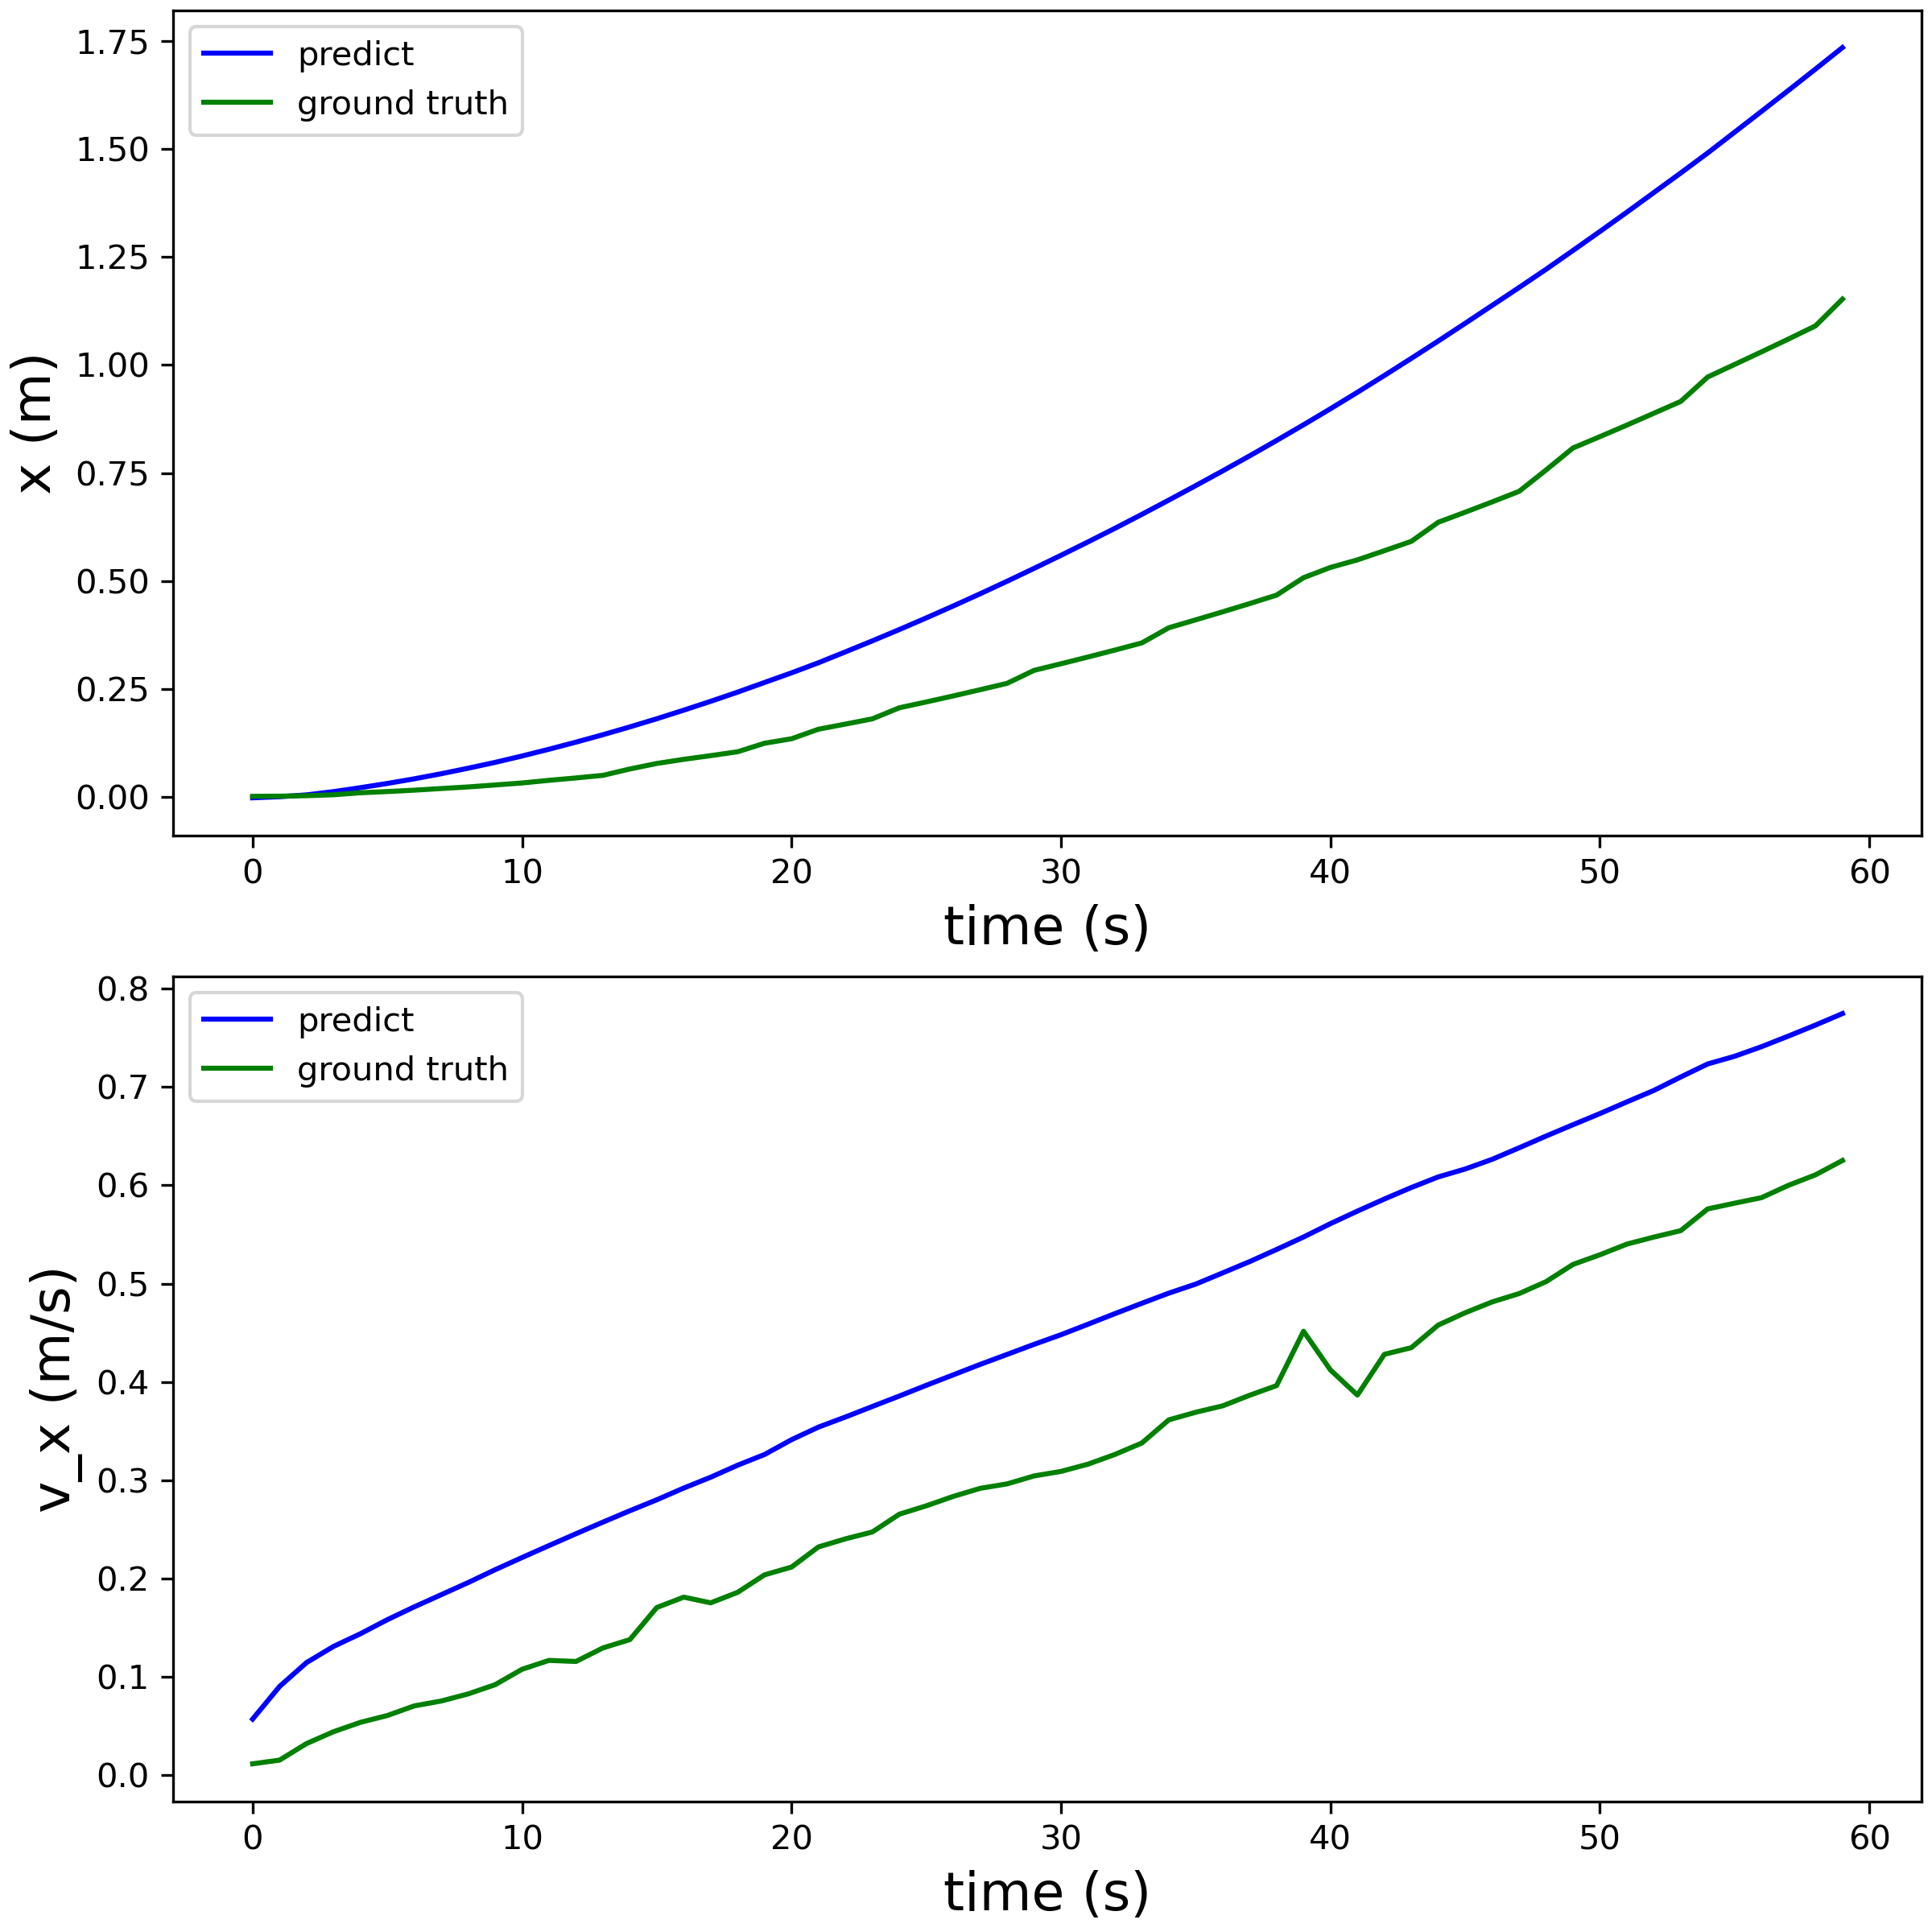
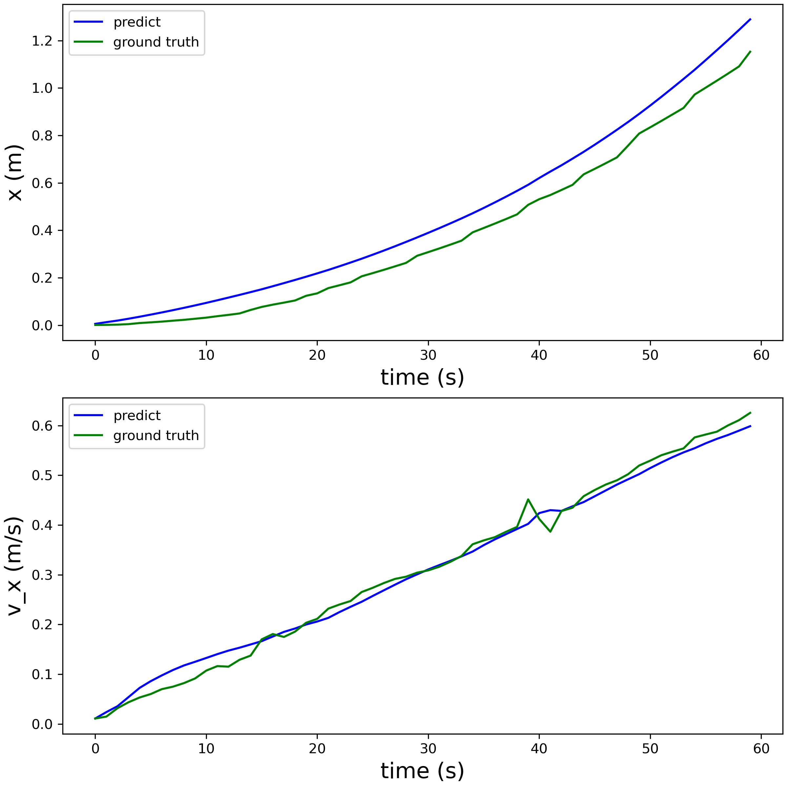
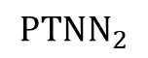
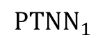
Preliminary Result of Acceleration Mode
Task: Given a series of inputs, predict the states of the system
Linear
Naive
$${PTNN}_{1}$$
$${PTNN}_{2}$$

Slide 26
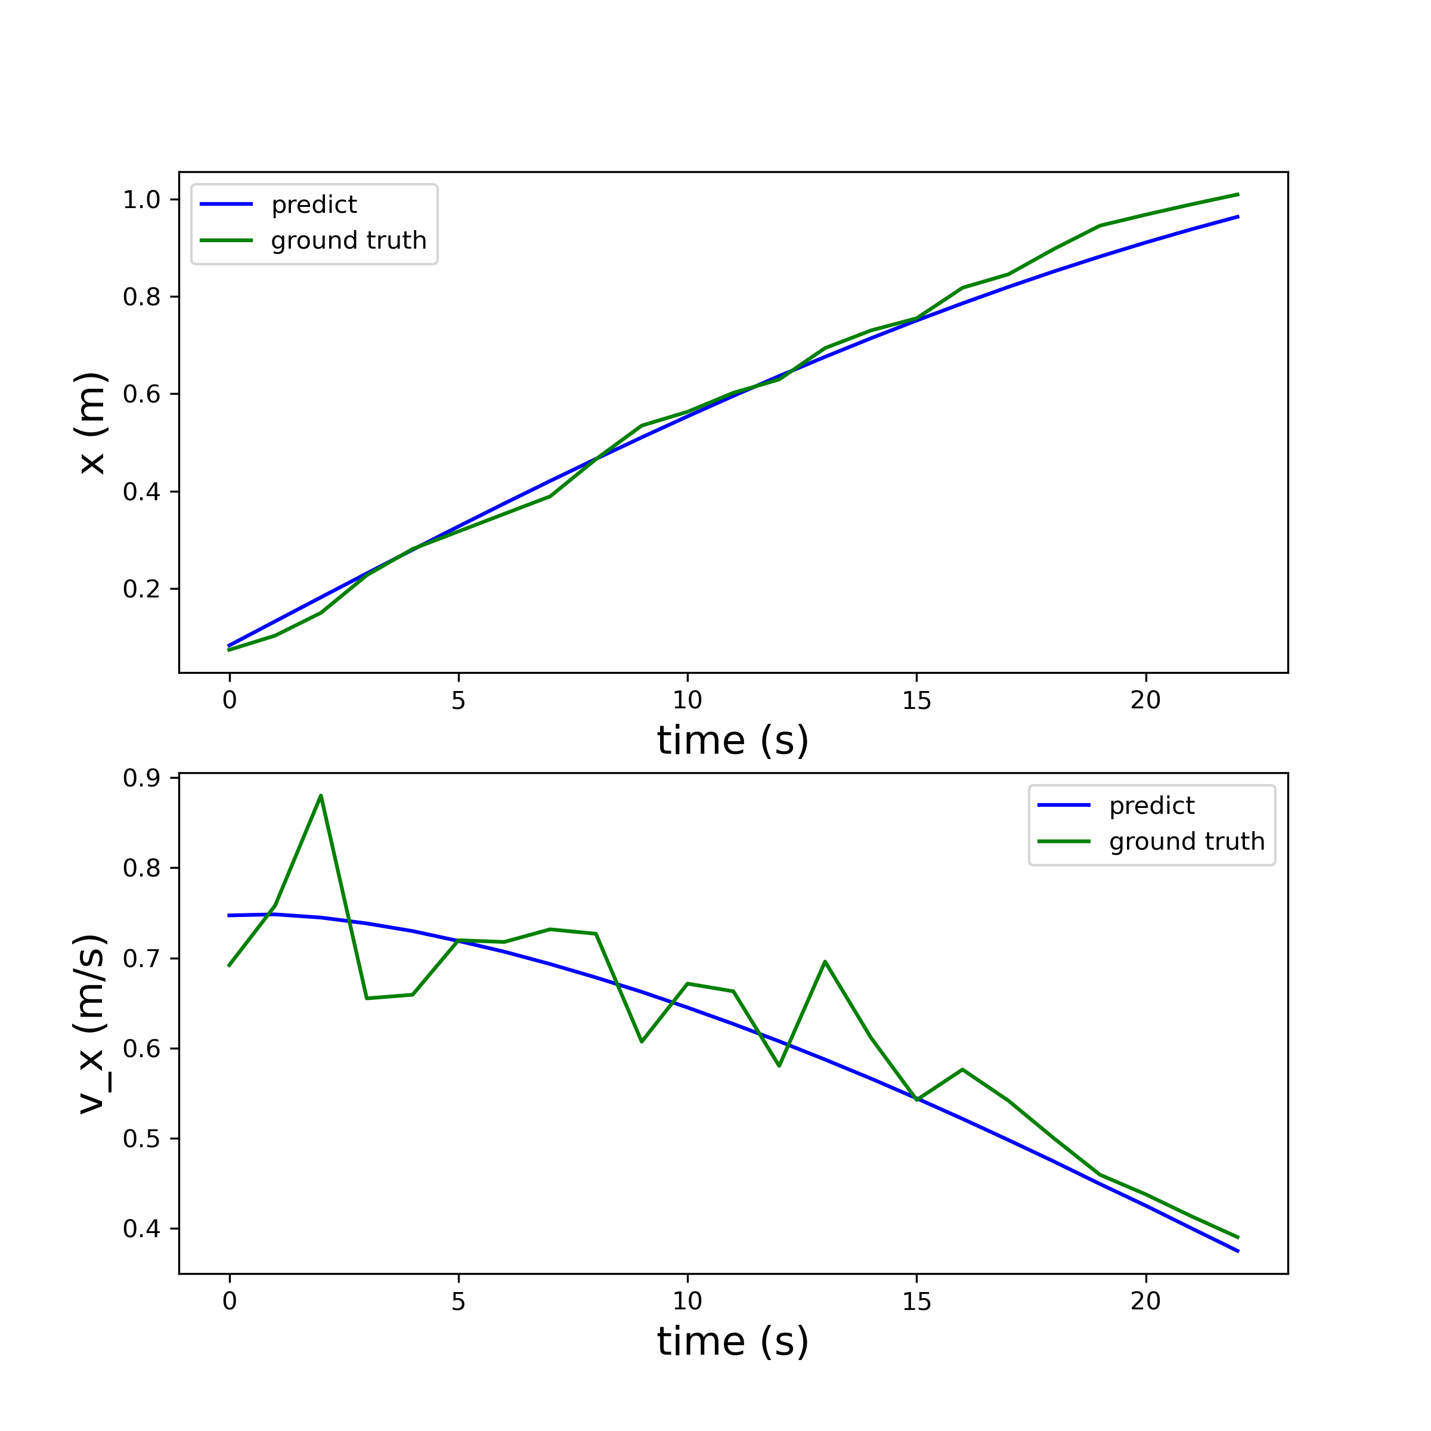
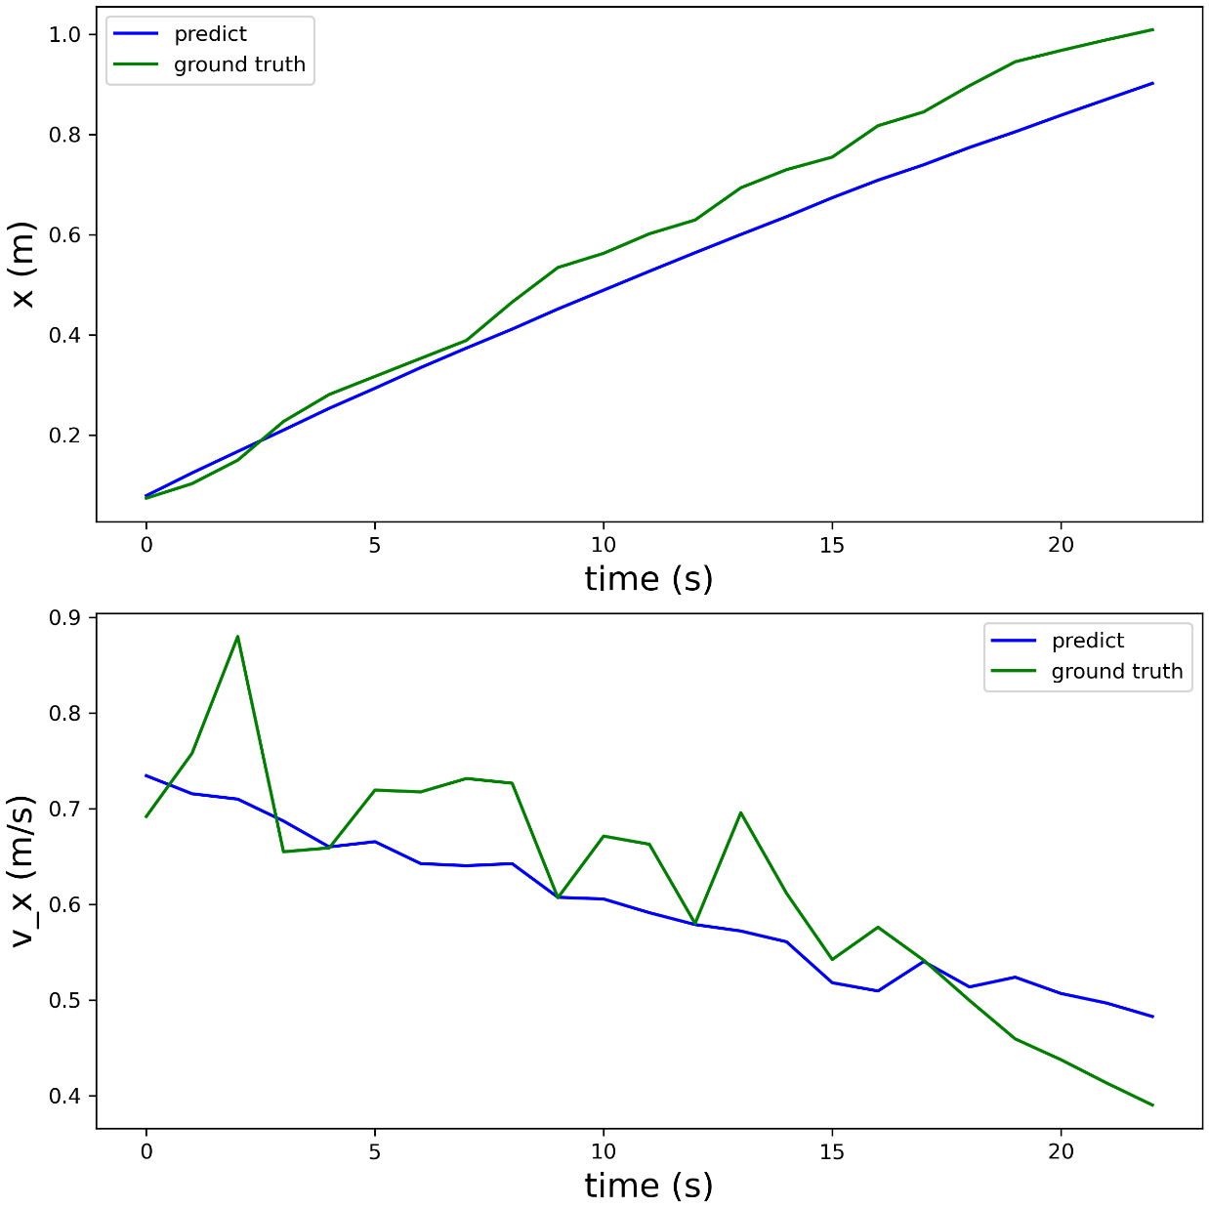
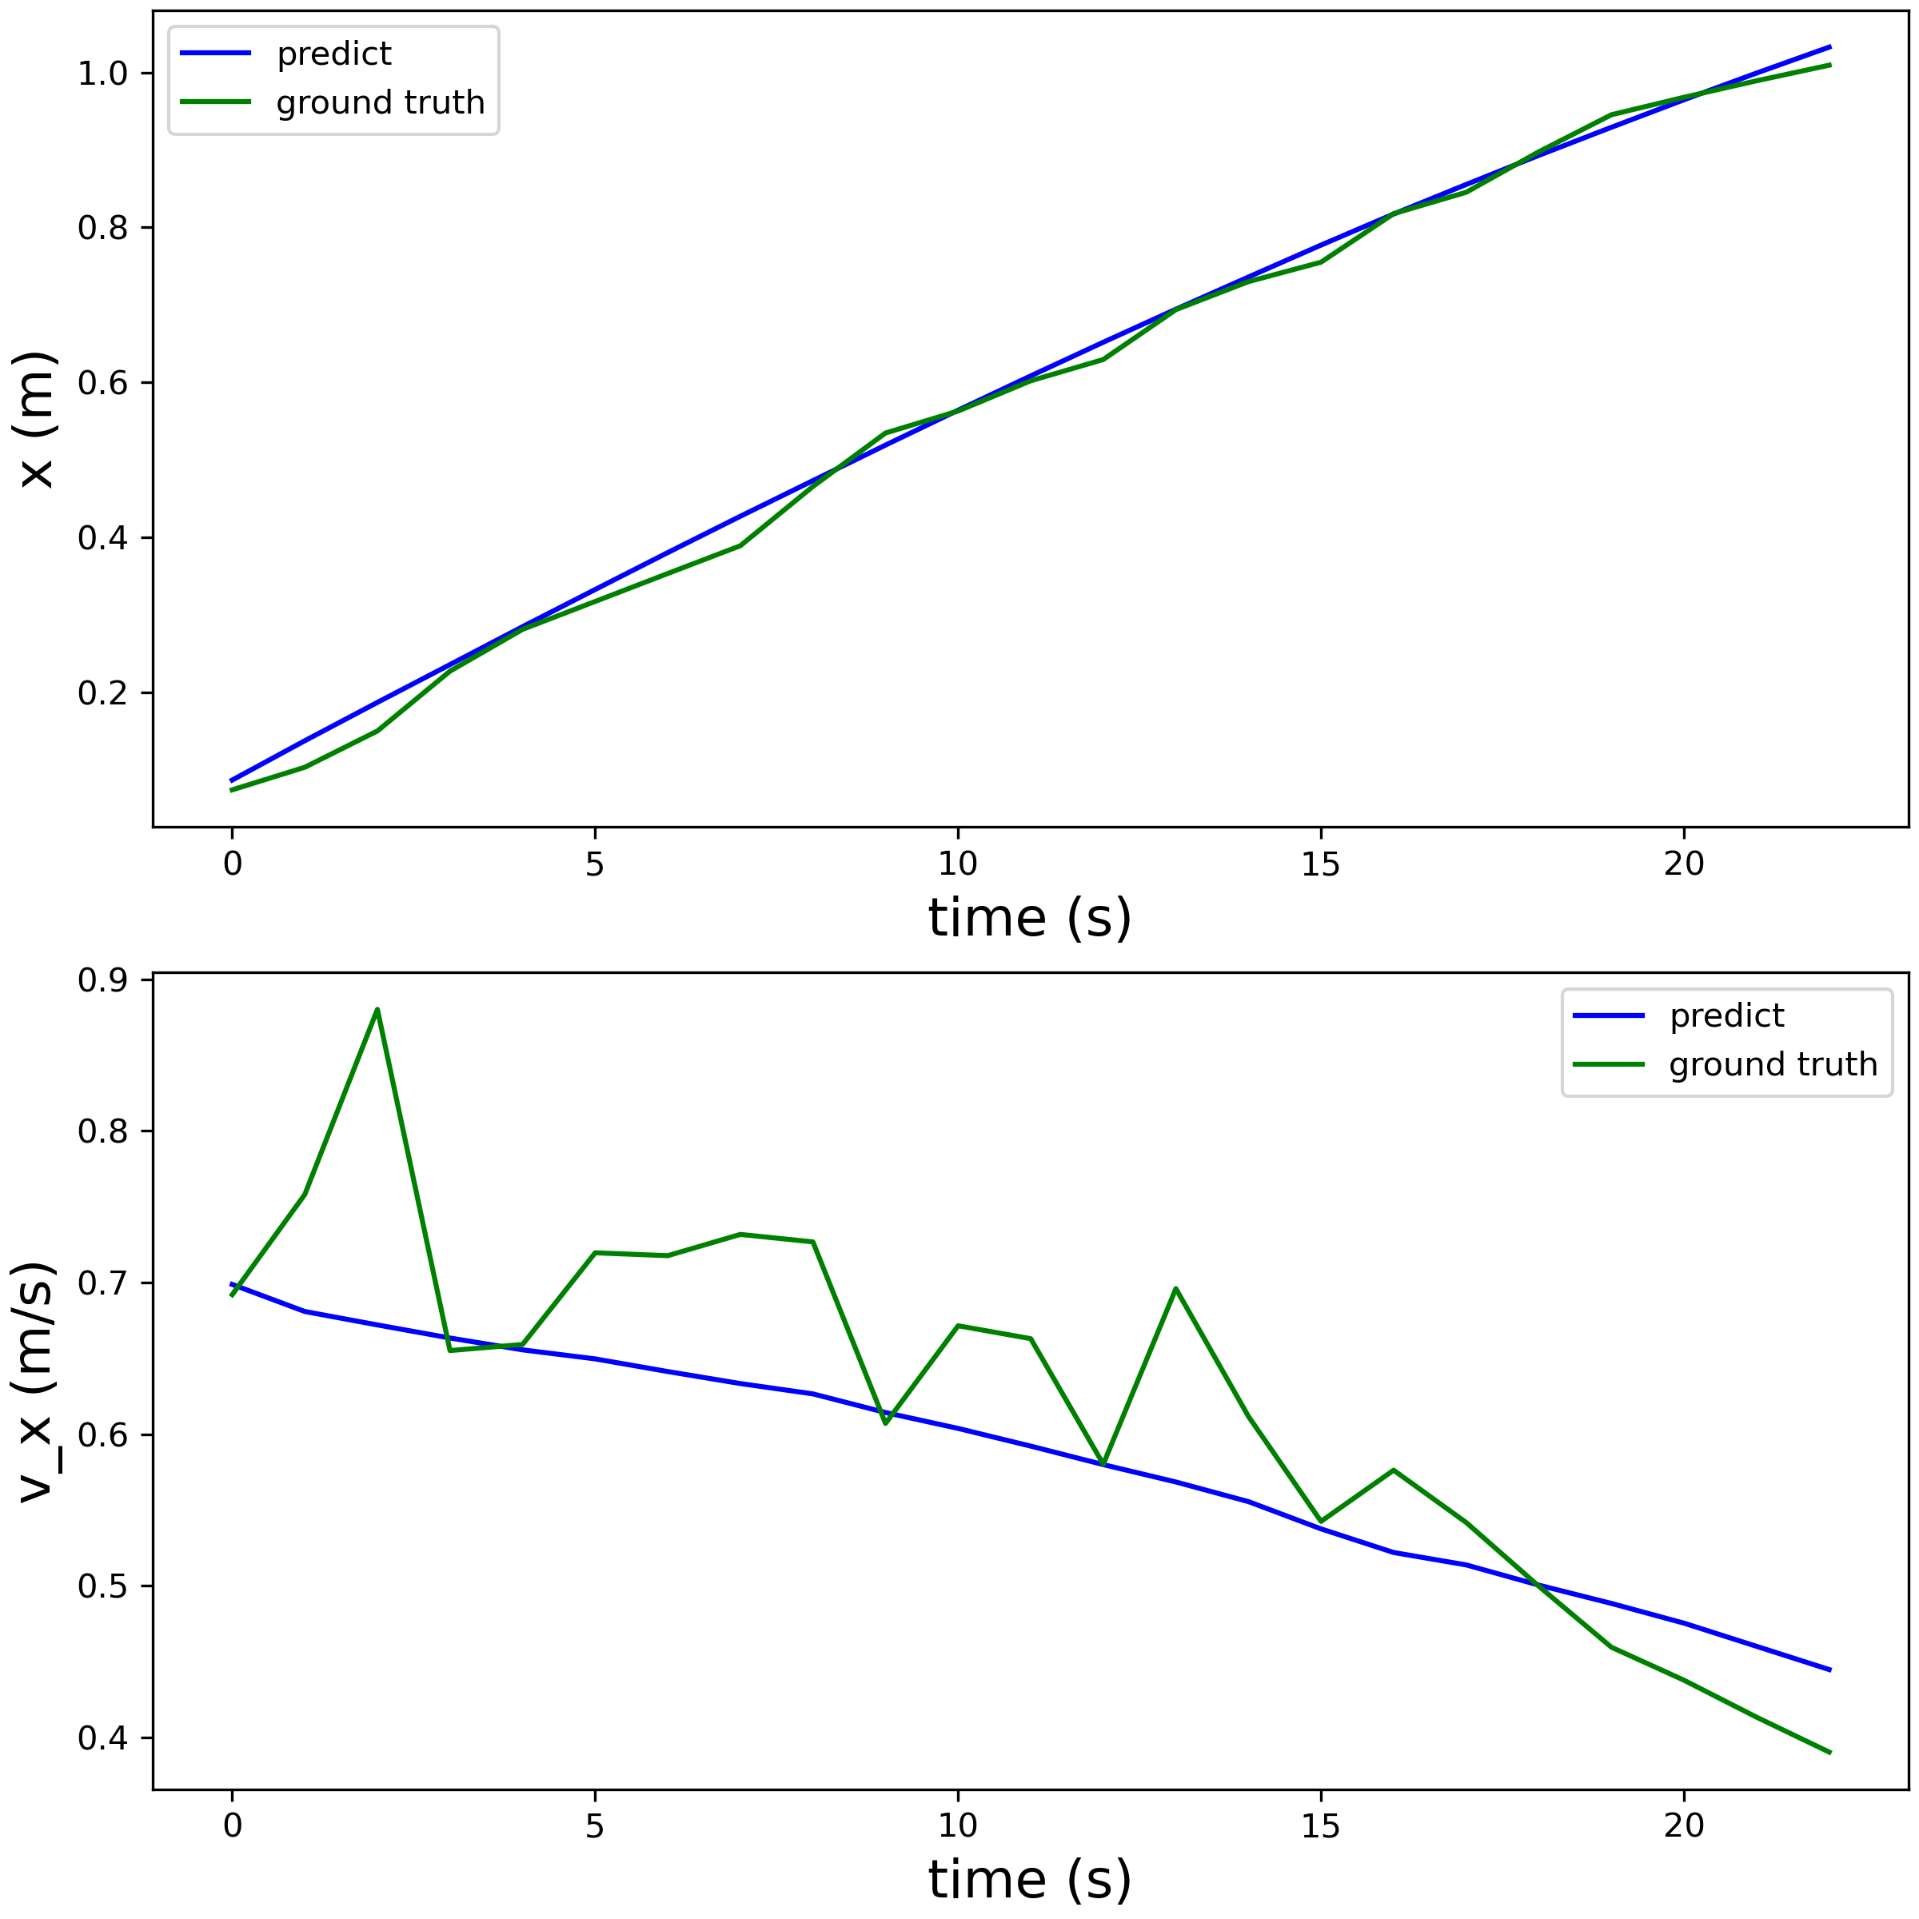
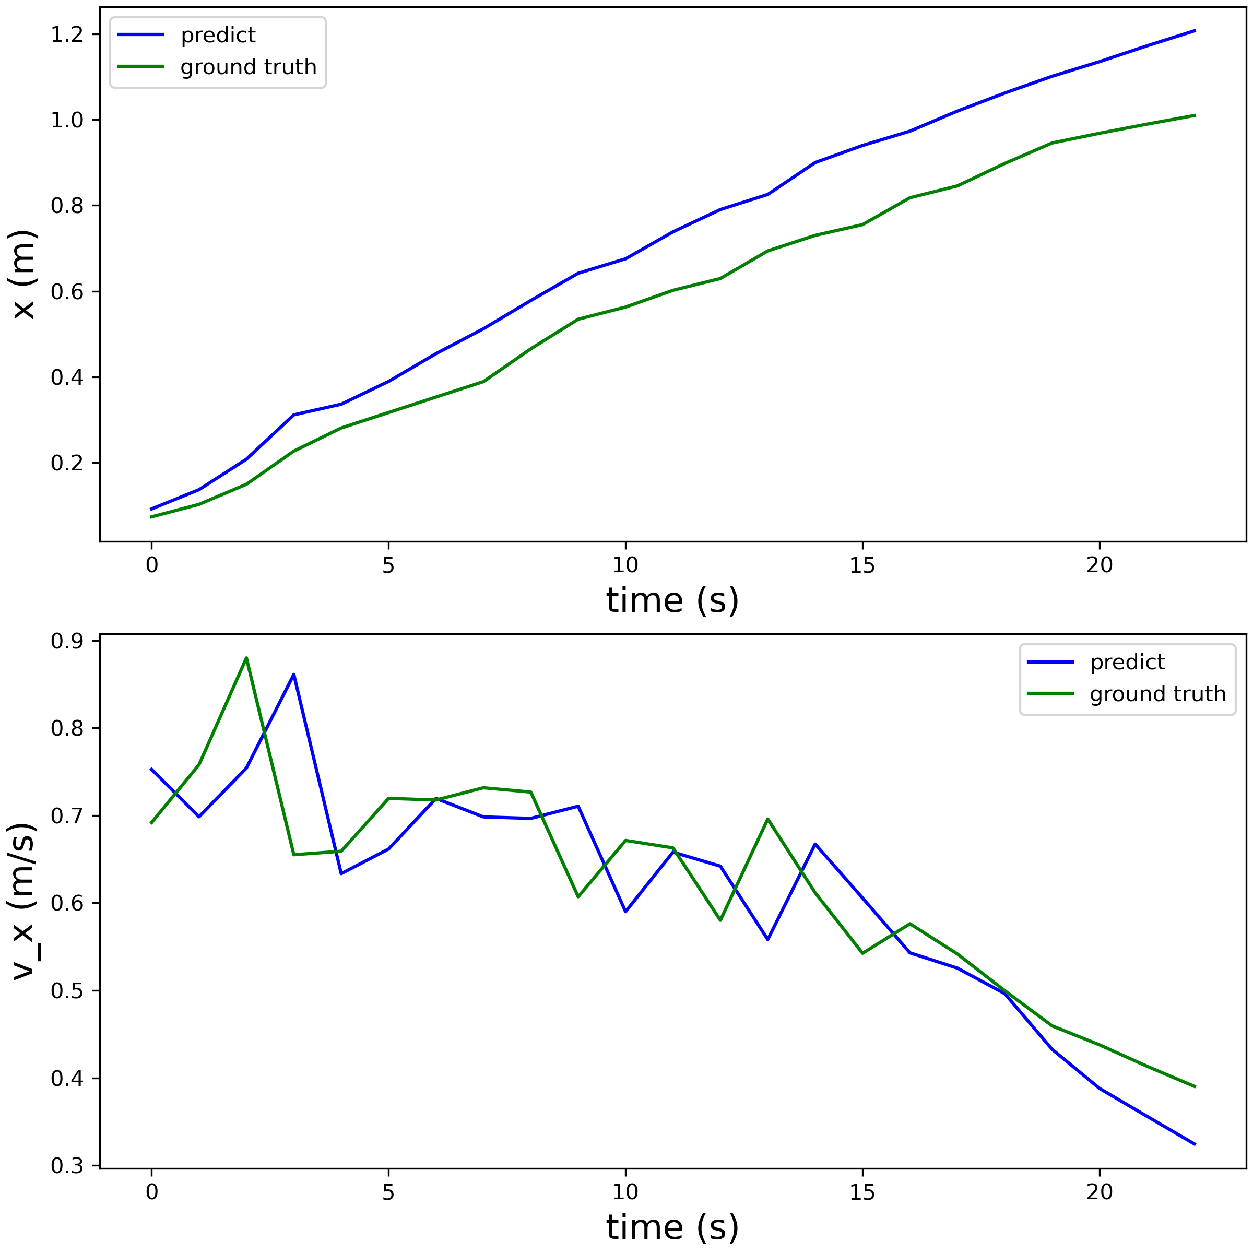
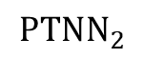
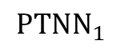
Preliminary Result of Deacceleration Mode
Task: Given a series of inputs, predict the states of the system
Linear
Naive
$${PTNN}_{1}$$
$${PTNN}_{2}$$

Slide 27
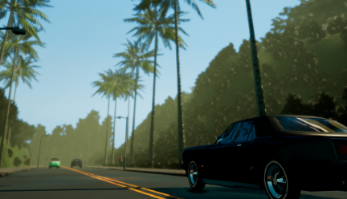
QCar Digital Twin in Carla
“Carla is an Open-source simulator for autonomous driving research.”
Very active community in both academic and industry
Broad ecosystem: Carsim, NVIDIA SimReady
High fidelity image compared to its counterparts
Good Expandability and friendly APIs

Slide 28
QCar Digital Twin in Carla
Carla Architecture
User Application
Carla Platform
Unreal Engine
User Application:
Retrieve Data
Apply Control
Set Policy & State
Unreal Engine:
Image Rendering
Physics Simulation
Assets Management
……
Carla:
Wrapped Actor
Traffic & Pedestrian
Map Management
Additional Runtime Environment
Reference: CARLA design - CARLA Simulator

Slide 29
QCar Digital Twin in Carla
To easy the problem setting, we setup our physical model in Carla by disable the internal physics engine and set the physical state by ourselves.
It should be notes that this brings new issues, but most of them could be solved in the future version.
Break the API
Slower simulation
No collision

Slide 30
QCar Digital Twin in Carla
Proposed Framework
2.a Sensor Collecting
2.b Physical State Update
3. World Tick
Digital Twin Component
1. Carla Loop

Slide 31
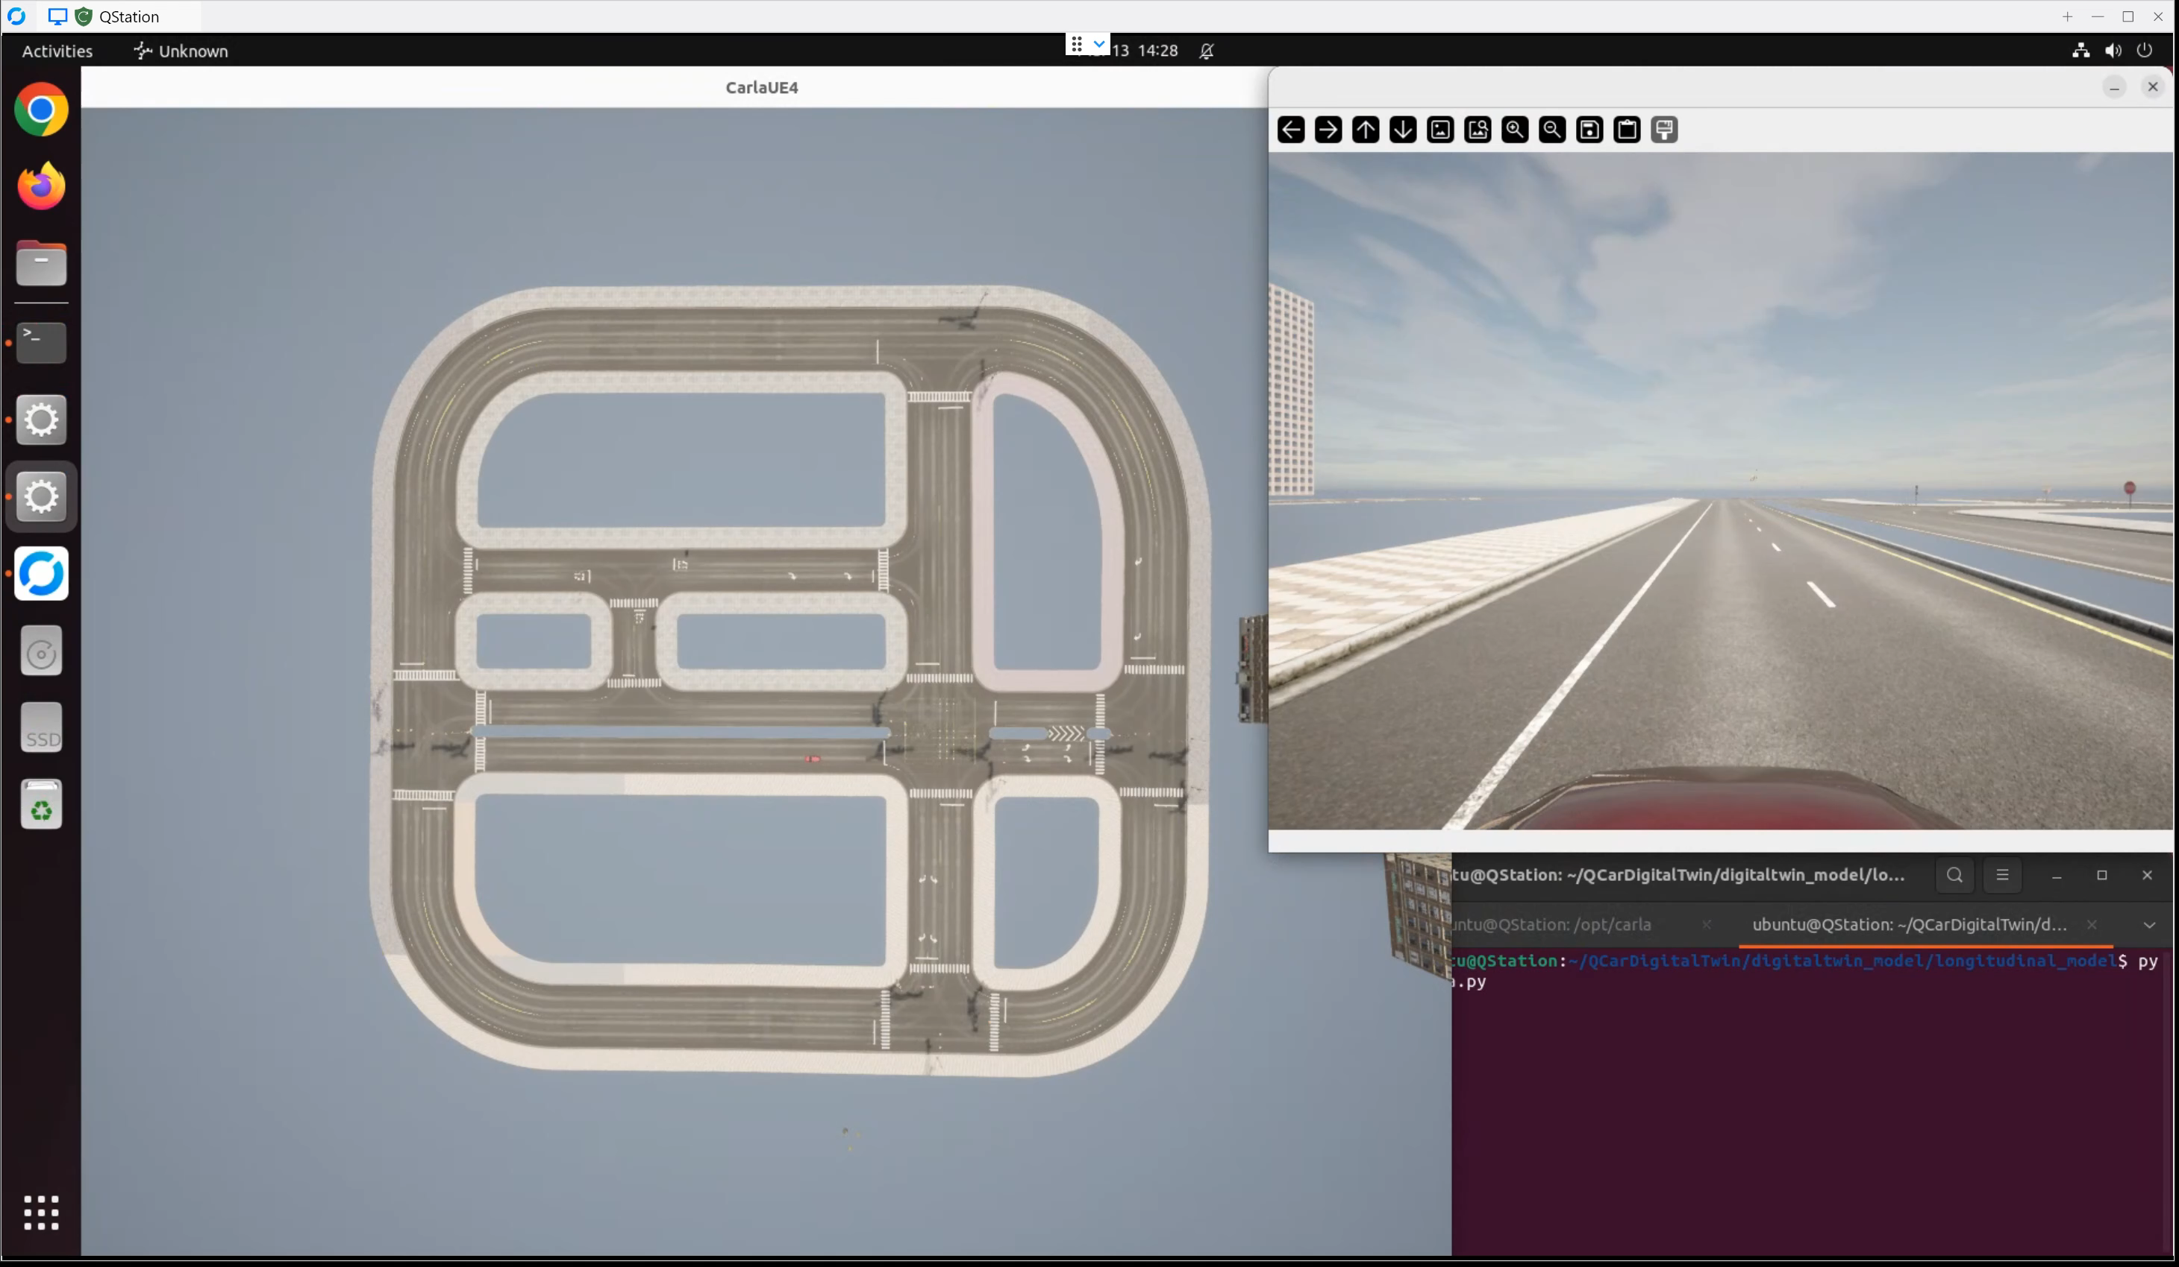
QCar Digital Twin in Carla
Demo Video

Slide 32
Thanks for listening

